Slide 1
UFT Test Automation Framework
Azzi
PMP, CSTE
HP QTP , LR and ALM certified , Devops

Slide 2
Framework?
Why Framework?
Dashboard Insights
Reusability
Set of Standards, Process,
Approach being followed
and
guide lines define for developing the scripts
Block Chain Assurance
Easy Maintenance
Data Driven
Other K&I Solutions (Big Data, Automation ,etc.)
Error handling
Less code – Easy to incorporate new changes
Common Understanding
Coding Standards, Review

Slide 3
Dashboard Insights
Reusability
Block Chain Assurance
Easy Maintenance
What Kind of
Framework
are we looking
Data Driven
Other K&I Solutions (Big Data, Automation ,etc.)
Support
Error handling
Less code – Easy to incorporate new changes
ALM Support
Test Externa Reporting –Pass/Fail
Screenshot - Failures

Slide 4
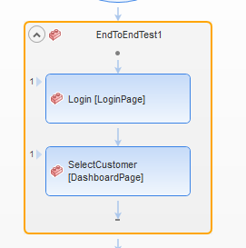
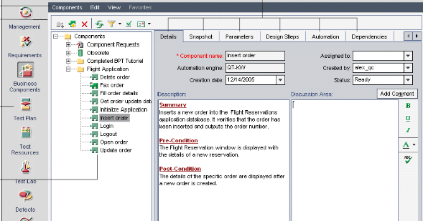
Actions
BPT
UFT Framework
UFT default recommend/support 2 types of framework.
And also UFT has built in Excel support functions.
Framework1 - Actions
Framework 2- BPT
BPT is best suite for the ERP applications like SAP and Oracle ERP

Slide 5
UFT Naming Standards

Slide 6
Frameworks Recommend
Answer is NO.
Used the built in UFT features Actions and Excel concepts
Customized the process and approach
Are they completely new frameworks?
Are they built from scratch?
How differ from the UFT recommend Action framework?
Framework 1 - LCAF
LESS CODE AUTOMATE FRAMEWORK
Framework 2- ETAF
EASY TO AUTOMATE FRAMEWORK
Framework 3 - ACAF
ANYBODY CAN AUTOMATE FRAMEWORK

Slide 7
Framework 1 - LCAF - Less Code Automate Framework
Design patterns -> Driver - Action Driven Framework
Driver Script
Controller File
Application Library
Test Flow file
Common Library
Adding the End to End Test in Excel
List of Components
Test Data File
Report Library
Actions
Dynamically loading actions.
One Driver script – No need of multiple driver scripts.
Easy to add/manage end to end Test
Components 1
Components 2
Error handling
Components 3
Components 3
Test Summary Report
Test Results
Screenshots

Slide 8
Framework 2 - ETAF -> Easy To Automate Framework
Design patterns -> Action Driven Framework
End to End TestScript1
End to End TestScrip2
End to End TestScript3
Create new End to End Test Script
Application Library
Test Data File
Test Data File
Test Data File
Common Library
Actions
Each end to end test requires script.
Static loading actions.
Report Library
Components 1
Components 2
Components 3
Components 4
Error handling
Test Summary Report
Test Results
Screenshots

Slide 9
Framework 3 - ACAF-> Anybody Can Automate Framework
Design patterns -> Keyword Driven Framework
Driver Script
Controller File
Application Library
Adding the End to End Manual Test in Excel
Common Library
Report Library
Test Flow File
Keyword File
Test Data File
Keywords Library
Error handling
One driver script – no need of multiple driver scripts.
Keywords drives the design and execution.
Test Results
Screenshots
Test Summary Report

Slide 10
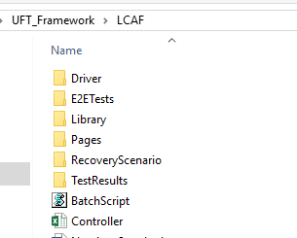
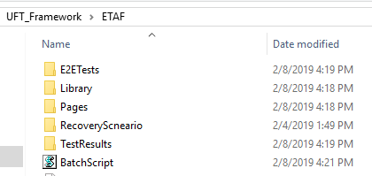
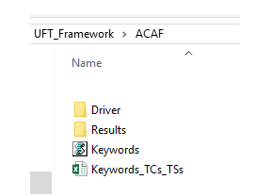
Folder Structure

Slide 11

Framework1
LCAF
Framework2
ETAF
Framework3
ACAF
Dashboard Insights
Reusability
Block Chain Assurance
Easy Maintenance
Data Driven
Other K&I Solutions (Big Data, Automation ,etc.)
Error handling
Less code – Easy to
incorporate new changes
ALM Support
UFT default support ALM integration, and framework also should support ALM integration. However Post ALM upgrade, will test ALM integration.
Test Externa
Reporting –Pass/Fail
Screenshot –
Failures

Slide 12
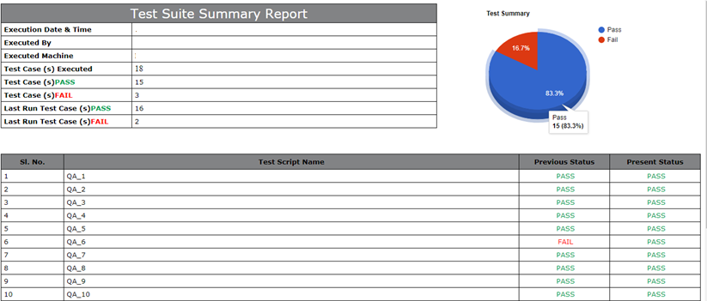
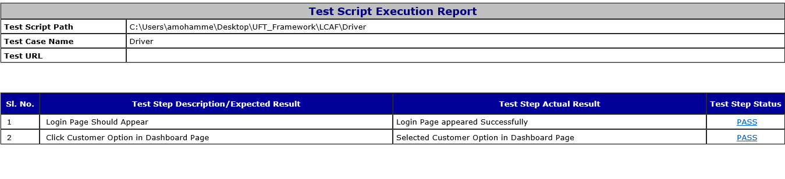
Executive Summary Report
Detail Report
Screenshots

